Slide 1

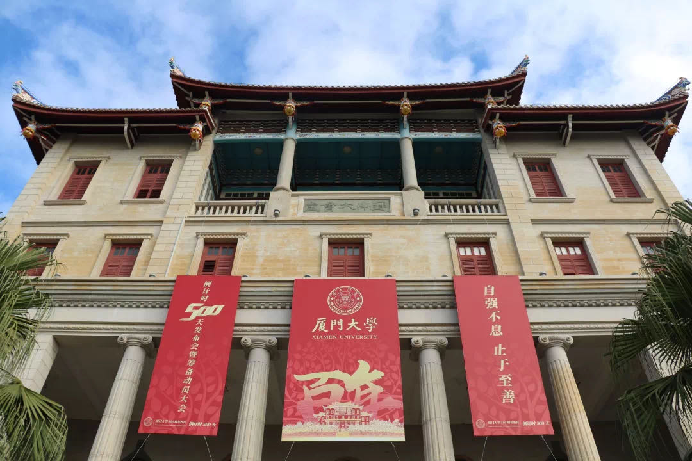





2.3
Procedural Techniques
--自强不息，止于至善--

Slide 2
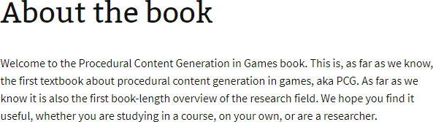
Stolen terms (bits, space, scenarios): Procedural Content Generation for Games: A Survey
https://course.ccs.neu.edu/cs5150f13/readings/hendrikx_pcgg.pdf
Search-Based Procedural Content Generation: A Taxonomy and Survey
https://course.ccs.neu.edu/cs5150f13/readings/togelius_sbpcg.pdf
PCG in Games: A textbook and an overview of current research (2016)
http://pcgbook.com
http://pcg.wikidot.com/
Free on website
Content is king!
PROCEDURAL CONTENT GENERATION

Slide 3
Procedural Content Generation
Use of computation instead of manual effort to produce elements of gameplay. Why?
Design aspects of the game
Save development cost (?)
Save storage or main memory (“infinite games”)
Adapt aspects of the game (player models)
In what games have you seen this? What’d you think?
What sorts of problems with PCG? What’s well suited?

Slide 4
What is PCG
Generating game content (levels, narrative, quests, visuals, sound, etc.) algorithmically.
Game bits (characters, visuals, sound)
Game space (levels, worlds, puzzles)
Game scenarios (story, quests, history)

Slide 5

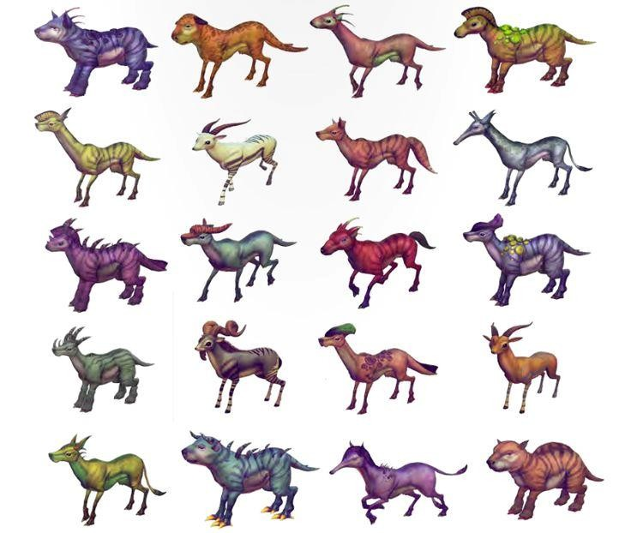
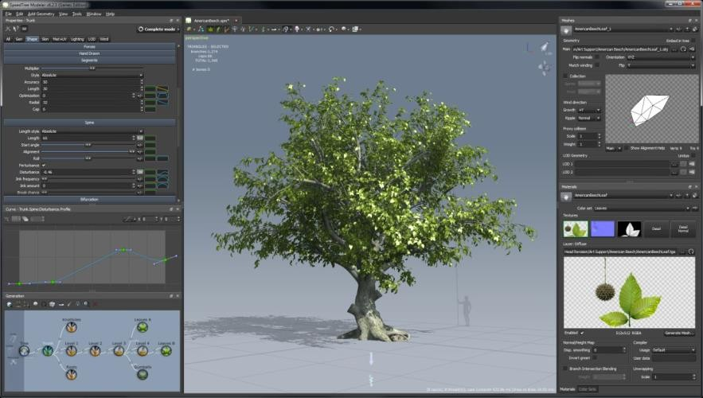
Game Bits (characters, visuals, sound)
Borderlands series
No Man’s Sky
SpeedTree

Slide 6
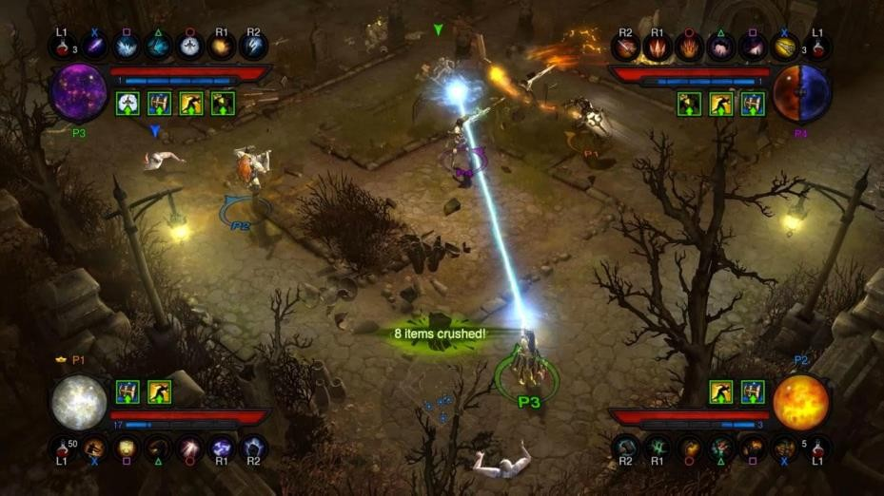
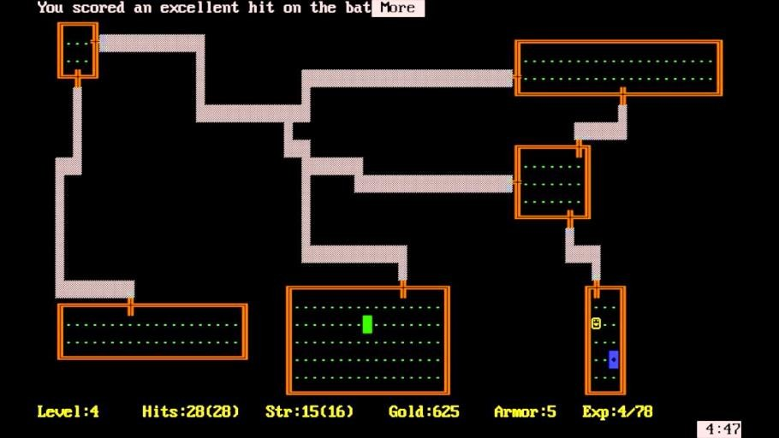
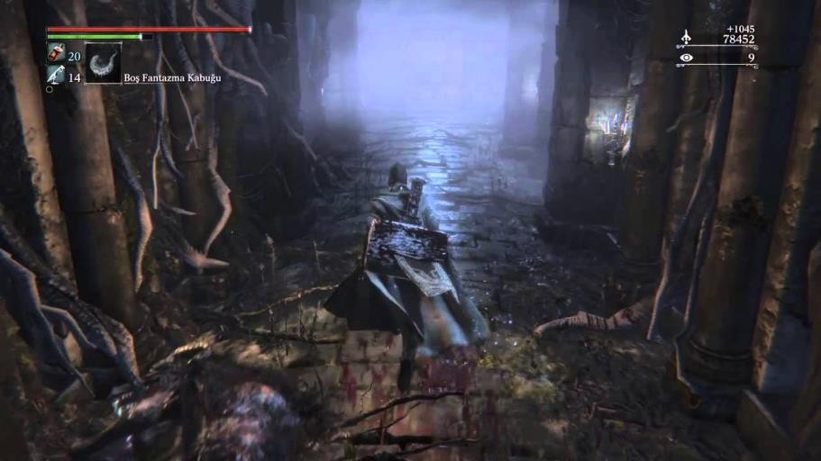
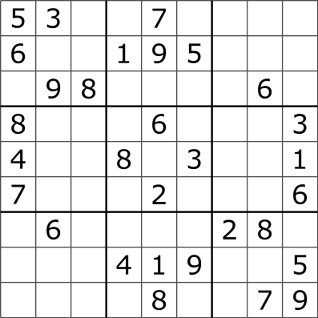
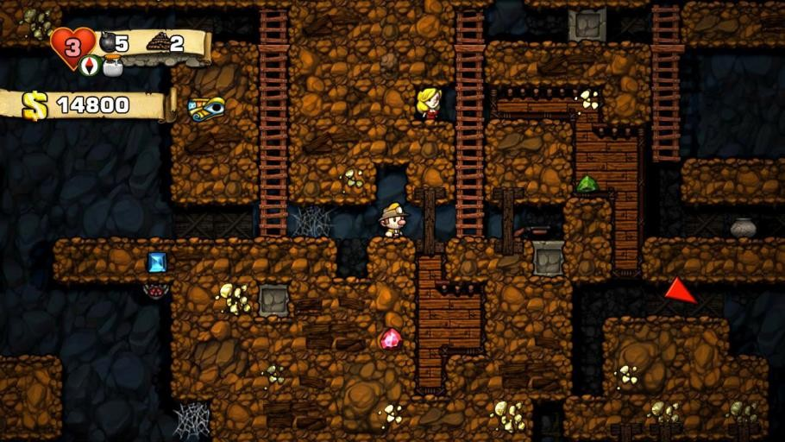
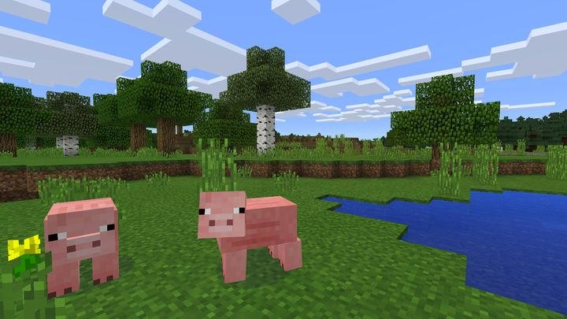
Game Space (levels, worlds, puzzles)
Sudoku
Rogue (1980)
Diablo 3
Bloodborne, Chalice Dungeons
Spelunky
Minecraft

Slide 7
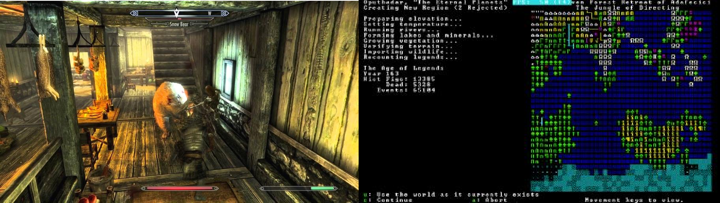
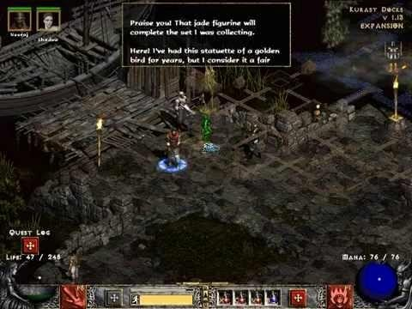
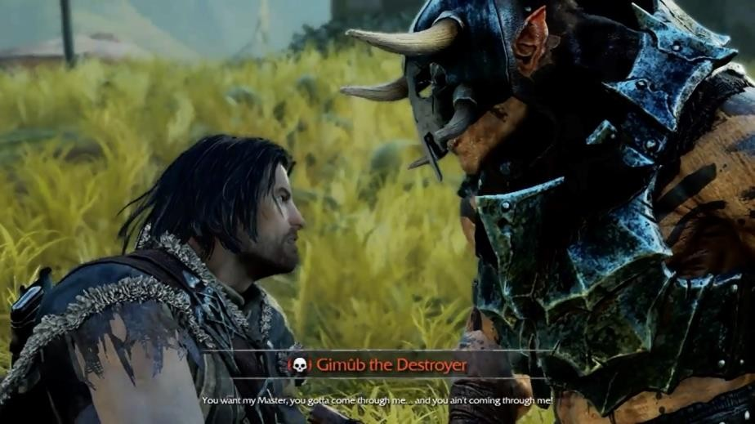
Game Scenarios (story, quests, history)
Skyrim, radiant quests
Dwarf Fortress
Diablo 2, randomizing situations
Shadow of Mordor

Slide 8
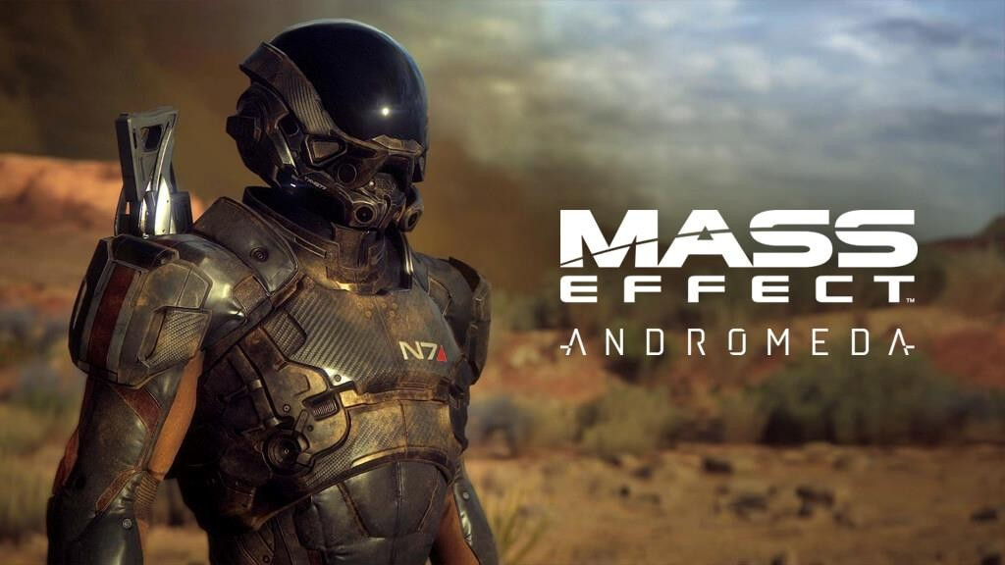
kotaku.com/the-story- behind-mass-effect- andromedas-troubled- five-1795886428

Slide 9
Why use PCG?
Reducing cost of creating content?
Yes, when clever (SpeedTree), but can add complications (Mass Effect Andromeda)
Exponentially increasing costs (levels, maps, missions, etc.)
CONTENT IS KING
If its interesting/personal/exciting to the player (Borderlands 2 guns), not if its bland oatmeal (No Man’s Sky)
Computed content saves:
development costs
Storage and/or main memory
Keep player playing/replaying
Adapting to player (Left4Dead AI director), new every time (Spelunky), or subarea (Bloodborne Chalice Dungeons)

Slide 10
Two Major Ways to use PCG
Runtime PCG: customization, dynamic adjustment, replayability
Generate content live in game (No Man’s Sky, Spelunky, Minecraft, Horizon Zero Dawn, etc)
Offline/Design-time/Developer PCG: Speed up design of static content
generate, pick best, and save content
generate then edit
generate and incorporate (Speedtree)

Slide 11
PCG high-level Methods
Rule systems
Generative Grammars
Search
Constraint Solving

Slide 12
PCG high-level Methods
Rule Systems allow for emergent output from simple rules. But hard to control output.
Generative grammars can create high-quality output, but depend upon expert authoring of components and rules
Search cuts back on authoring burden to just a heuristic and searchable representation, but these are unintuitive for many designers

Slide 13
History
Level generation was an early feature of games
Games weren’t professionally developed
Memory and storage was limited
Processors also limited
Tradeoff between memory/storage and processor was important
Random generation was the answer

Slide 14
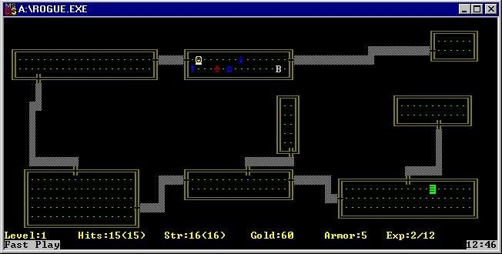
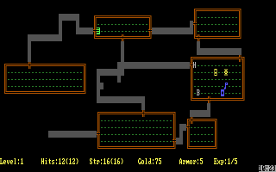
History
Rogue (AI Design, 1983)
http://www.abandonia.com/en/games/982/Rogue+-+The+Adventure+Game.html
Granddaddy of all rpg dungeon-crawlers
Unlimited replay: dungeons + monsters PCG

Slide 15
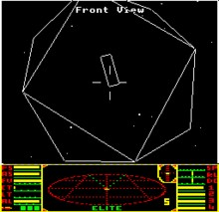
History
Elite (Acornsoft, 1984)
http://www.iancgbell.clara.net/elite/
Space trading (piracy, trade, military, etc.)
Original plan: 248 galaxies (~282 trillion), 256 solar systems each
Final: 8 galaxies
Planet pos., commodity prices, name/local details
Model for Wing Commander, Grand Theft Auto, EVE online; influenced Second Life, World Of Warcraft…

Slide 16
History
The Sentinel (Firebird, 1986)
http://www.youtube.com/watch?v=9V_pgo3vgiI
“The first VR game”
10,000 levels
Pseudorandom number generators (again)
landscape from the 8-digit number given at the completion of a previous landscape
Not all landscapes tested; possible to skip difficult levels by rebeating earlier one
Consolidated list:
http://en.wikipedia.org/wiki/Procedural_generation#Software_examples

Slide 17
Why industry considers PCG
Development cost savings
Replayability (e.g. easing permadeath)
Customization/adaptation
Dynamic difficulty adjustment
Flow theory
C.f. http://en.wikipedia.org/wiki/Flow_(psychology)
http://jenovachen.com/flowingames/designfig.htm
http://en.wikipedia.org/wiki/Flow_(video_game)

Slide 18
Design time PCG
Graphical asset construction is also consuming development time
# of unique objects in the world
Players expect non-repetitive
Game dev times now 100s of man-years with huge design teams
Cost savings therefore a strong motivation
But there are risks:
Procedures can do stupid things that destroy the player experience
Game design process exists to maximize control of design

Slide 19
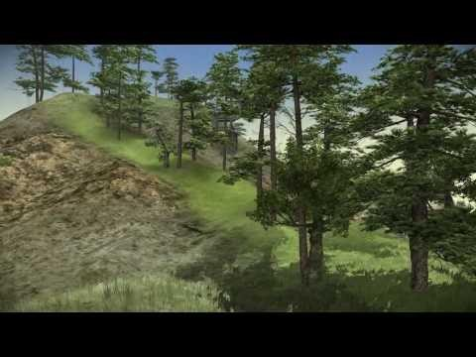
Design time PCG
Typically a mix of designer provided assets and procedural use of assets
Speedtree
CityEngine:
Terragen
Star Trek Nemesis
Golden Compass
TV Commercials
CityEngine: http://www.esri.com/software/cityengine/

Slide 20
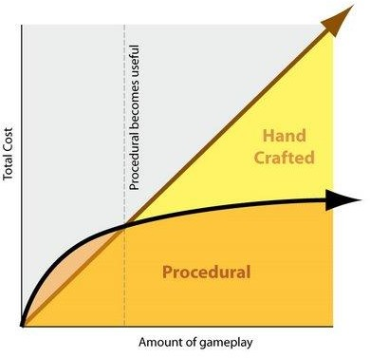
Economies of scale

Slide 21
Types of content
Throw away
Reusable
Handcrafted anything is expensive and hard to modify
The more handcrafted throwaway content, the less agile development, and more time spent on things the players don’t appreciate
PCG doesn’t have to be human-level; just “good enough”

Slide 22
Run time PCG
Players are different
Preferences for pace and playstyle
Moderate challenge levels
Help avoid getting stuck
Adapt to player’s tastes
Detecting player exploits
When to use run-time PCG
When decisions can only be made at run-time
When you just can’t pre-compute due to storage/memory limits
Optimization problem
What is the set of content that delivers the optimal experience to the player given individual differences?
Example: rubber banding

Slide 23
Player Modeling
What is optimal in PCG?
Need a player model
Tells you something about the player
Makes predictions about player
Challenges in player modeling:
What do you model?
Where do you get the model?
How do you use the model?

Slide 24
Promises
Instancing in-game entities (especially appearance)
NPC histories
Puzzles that are harder or easier
Puzzles/levels with more than one solution
Story generation
Pacing
Different, multiple endings
Meaningful choices
Extending game lifetime

Slide 25
Pitfalls / Risks
PCG can be NP-hard for anything non-trivial
But you can’t always make players wait
Thorough testing of run-time PCG is impossible
Best you can do is statistical sampling
Offensive material
Bad content
Algorithm crash
Meaningless activities
Easy to create quests, but if they don’t connect to the larger game, no one cares

Slide 26
Hard problems in PCG
Procedures structuring player’s experience
Narrative
Mental models of players
Statistical player models
Avoiding (dealing with) occasional catastrophic failure
Algorithm safety
Healing a broken level
Social factors and full expressiveness with story/language generation
“Deep understanding” vs. “generate & test”
Personalized generated content
Destiny
It’s easy to have infinite levels, but dungeon crawling gets boring without a sense of progression/achievement
How do you know you are generating something interesting?

Slide 27
2.4
Reinforcement Learning
--自强不息，止于至善--

Slide 28
Situating RL
The BLUF: RL is about learning from interaction about how to map situations to actions to maximize reward. Key elements:
Trial-and-error search: must discover which actions yield most reward by trying them
Delayed reward: actions may affect both immediate reward and also next situation and all subsequent rewards
Different from:
Supervised learning: training set of labeled examples
Unsupervised learning: finding latent structure in unlabeled data
RL: maximize reward signal rather than discover hidden structure

Slide 29
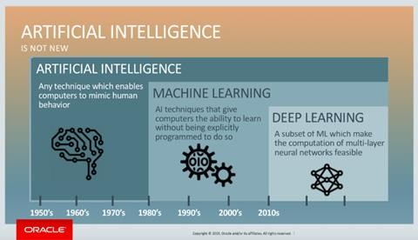
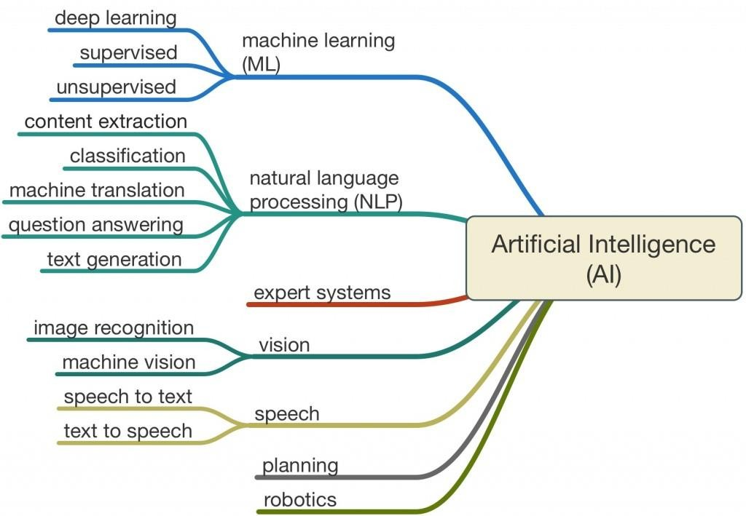
Organizing our thoughts
https://blogs.oracle.com/bigdata/difference-ai-machine- learning-deep-learning
http://www.legalexecutiveinstitute.com/artificial-intelligence-
in-law-the-state-of-play-2016-part-1/

Slide 30
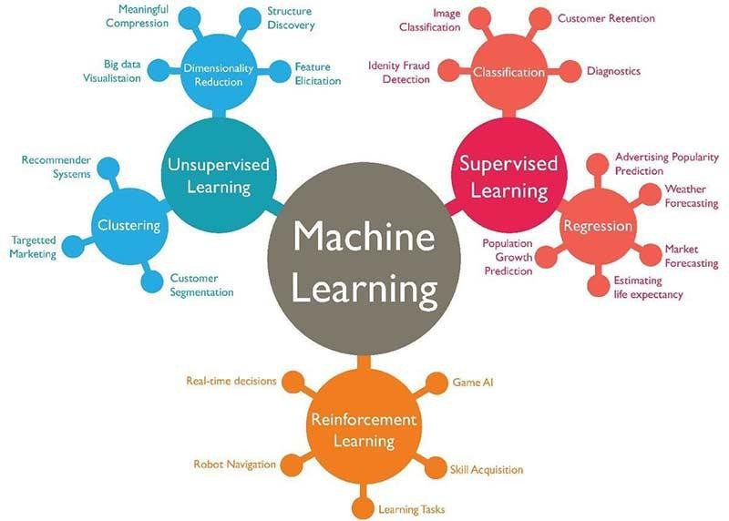
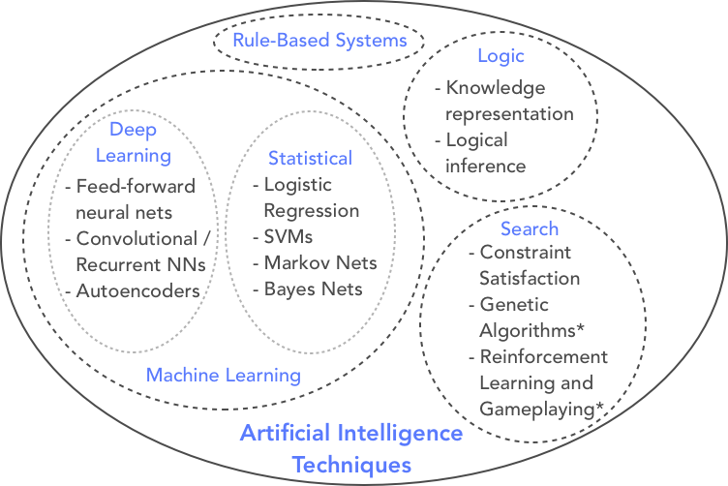
Mind Map / Family Tree
https://www.techleer.com/articles/203-machine-learning-
algorithm-backbone-of-emerging-technologies/
https://blog.eloquent.ai/2018/08/15/the-ai-landscape/

Slide 31
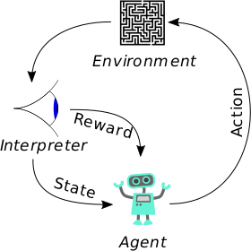
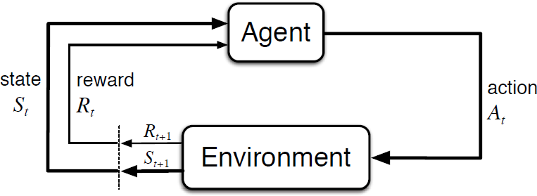
By Megajuice - Own work, CC0, https://commons.wikimedia.org/w/index.php?curid=57895741
Sutton & Bartow, Fig 3.1

Slide 32
Fundamental Classes of Methods
Dynamic programming
Mathematically well understood but require a complete and accurate model of the environment
Monte Carlo methods
Model free and conceptually simple, but not well suited for step-by-step incremental computation
Temporal-difference learning
Model free and fully incremental, but difficult to analyze
Also differ in efficiency/speed of convergence

Slide 33
RL Has Revolutionized AI Gameplay
Reinforcement Learning has been shown to be able to master many computer games
most Atari Games, Backgammon, Go, DOTA2, and StarCraft II.
Reinforcement Learning (RL) is a class of algorithms that solve a Markov Decision Process. That is, the agent is given:
S: A set of all states the agent could encounter. Games: S is all configurations of pixels that the game engine can render
A: A set of all actions. Games: all player commands
T: A transition function that indicates the probability of transitioning from one state to another state if a particular action is chosen. We will assume that T is unknown.
R: A reward function that computes a score for every state in S. Games: reward given either based on in-game score, or for finishing a level, or achieving an objective.

Slide 34
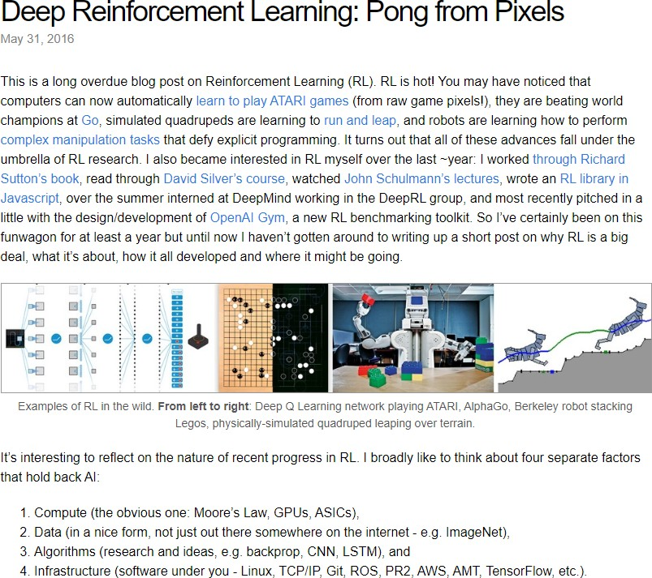
http://karpathy.github.io/2016/05/31/rl/

Slide 35
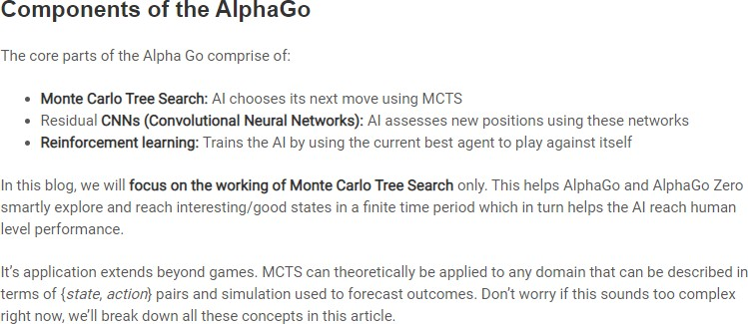
https://www.analyticsvidhya.com/blog/2019/01/monte-carlo-tree- search-introduction-algorithm-deepmind-alphago/
https://www.youtube.com/watch?v=0g9SlVdv1PY

Slide 36
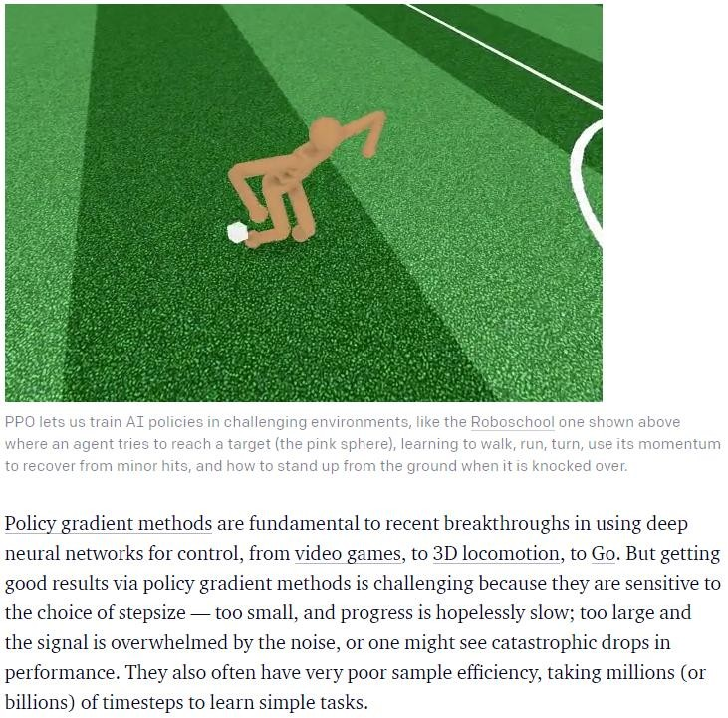
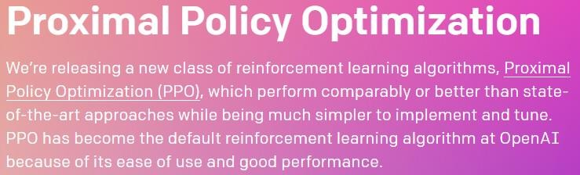
https://openai.com/blog/openai-baselines-ppo/

Slide 37
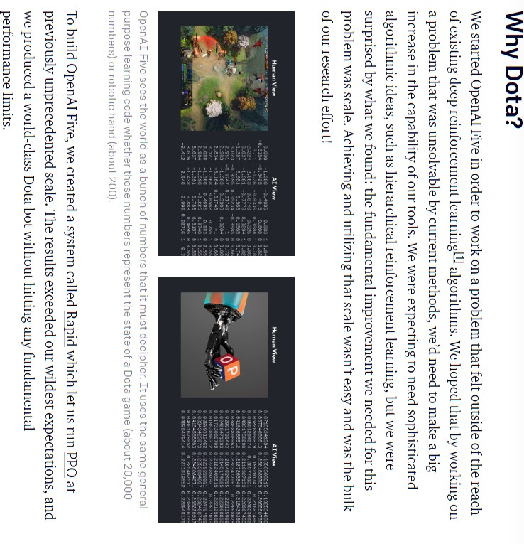
https://openai.com/blog/how-to-train-your-openai-five/
https://openai.com/blog/how-to-train-your-openai-five/
https://openai.com/blog/how-to-train-your-openai-five/
https://openai.com/blog/how-to-train-your-openai-five/
https://openai.com/blog/how-to-train-your-openai-five/
https://openai.com/blog/how-to-train-your-openai-five/
https://openai.com/blog/how-to-train-your-openai-five/

Slide 38
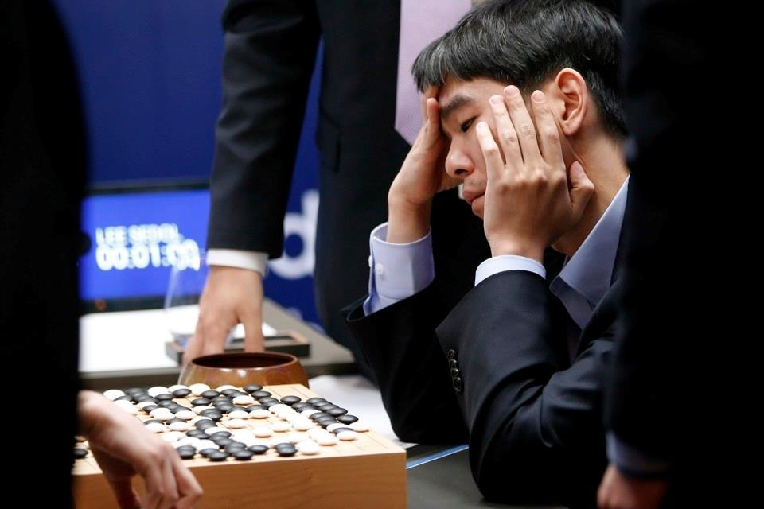
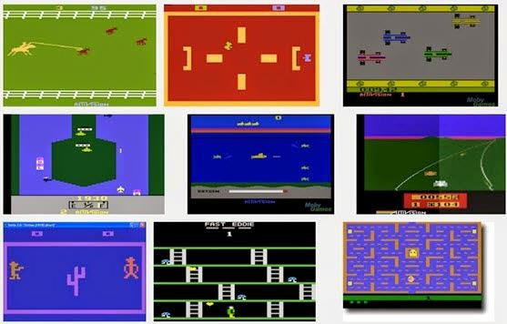
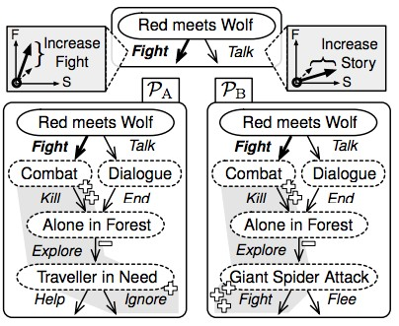
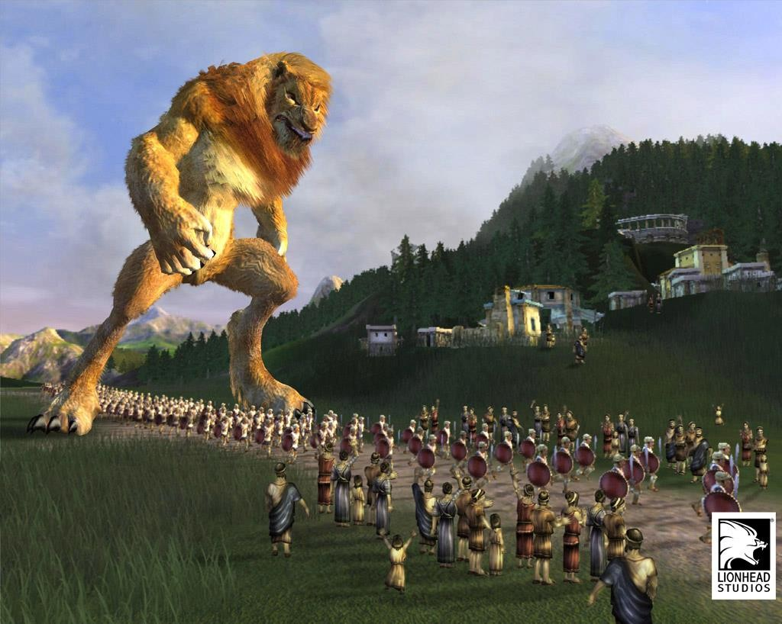
Reinforcement Learning in Games

Slide 39
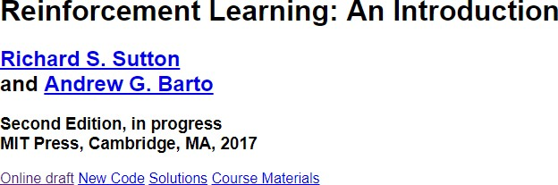
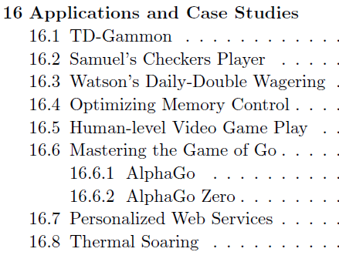
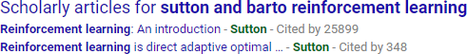
http://incompleteideas.net/book/the-book-2nd.html

Slide 40

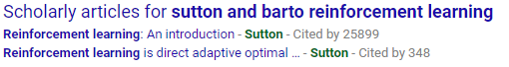
One-armed Bandit Problem
Notes:
【强化学习1.0】导论 & 多臂赌博机问题（multi-armed bandit） - 知乎 (zhihu.com)
强化学习——多臂老虎机问题 - 知乎 (zhihu.com)

Slide 41

One-armed Bandit Process
Pull # | Response | Believed Probability of Jackpot
1 | WIN (1.0) | 1.0
2 | LOSS (0.0) | 0.5
3 | LOSS (0.0) | 0.33…
4 | LOSS (0.0) | 0.25
… | … | …
N. | LOSS (0.0) | 0.1
Unknown True Probability

Slide 42



Multi-armed Bandit Problem
“Through repeated action selections you are to maximize your winnings by concentrating your actions on the
best levers.” – Sutton & Barto

Slide 43
Now what?
We can’t just keep playing one bandit to figure out its potential for reward (money)
Want to maximize reward across all bandits
We need to trade off making money with current knowledge and gaining knowledge – Exploitation vs. Exploration
Exploitation vs. Exploration

Slide 44
Just Exploitation
Greedy Strategy where we always pick the machine we think will give us the best reward (reminder: machines give rewards according to a probability)
Machin e | Response | Belief (G,R,B)
B | LOSS | (-,-,0.0)
R | WIN | (0,1,0)
G | LOSS | (0,1,0)
R | LOSS | (0,0.5,0)
… | … | …
50%
25%
10%

Slide 45
Just Exploration
Always just pick a random machine, no matter what we believe.
Machin e | Response | Belief (G,R,B)
B | LOSS | (-,-,0.0)
R | WIN | (0,1,0)
G | LOSS | (0,1,0)
B | LOSS | (0,1,0)
… | … | …
50%
25%
10%

Slide 46
Epsilon (ϵ) Greedy (ϵ-Greedy)
(ϵ=0.1)
90% of the time try the best machine according to our current beliefs
10% of the time take random action
Now we can “escape” from early greedy mistakes!

Slide 47
Regret
Imagine a perfect agent, who always takes the best action
We can compare that agent’s payout with our agent’s payout for each action to get the regret for that step
Summing regret across all time steps gives us the total regret
Maximize total reward == minimize total regret

Slide 48
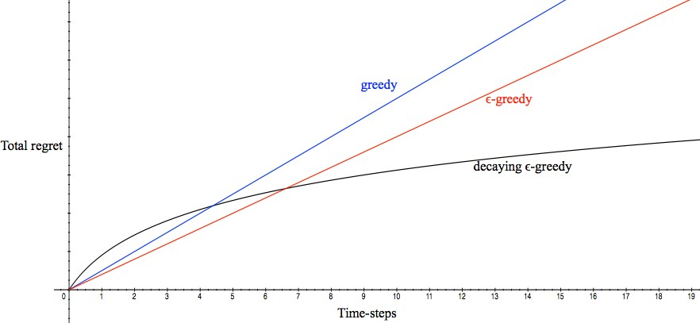
Different Strategies and Regret

Slide 49
Decaying ϵ-Greedy
Drop ϵ lower and lower according to some schedule
Now: logarithmic asymptotic regret
Downside: we need to have enough domain knowledge to come up with a schedule beforehand

Slide 50








What does this have to do with games?
We can imagine mapping this onto a video game domain
Each distinct machine is now a distinct action
Reward: Not dying, end of level, etc.
jump
left
right

Slide 51









But these values will probably differ based on context…
Value of going left versus right will be different if an enemy is to the left or the right.

Slide 52
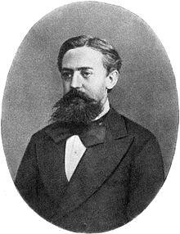
State
Multi-armed bandit problem is a “single state” or “stateless” Markov Decision Process
But in games (and most cases we care about) there is more than one state
Andrey Markov

Slide 53
Markov Decision Process
S: finite set of states
A: finite set of actions
P(s,s₁): Probability that action a takes us from state s to state s₁
R(s,s₁): Reward for transitioning from state s to state s₁
y: Discount factor ([0-1]). Demonstrates the difference in importance between future awards and present awards

Slide 54
High-level Idea
If the multi-armed bandit problem was a single state MDP, we can think of learning a strategy to play a game as solving this problem for every state of the game
jump
left
right

Slide 55
Markovian State
We call a state representation Markovian if it has all the information we need to make an optimal decision

Slide 56
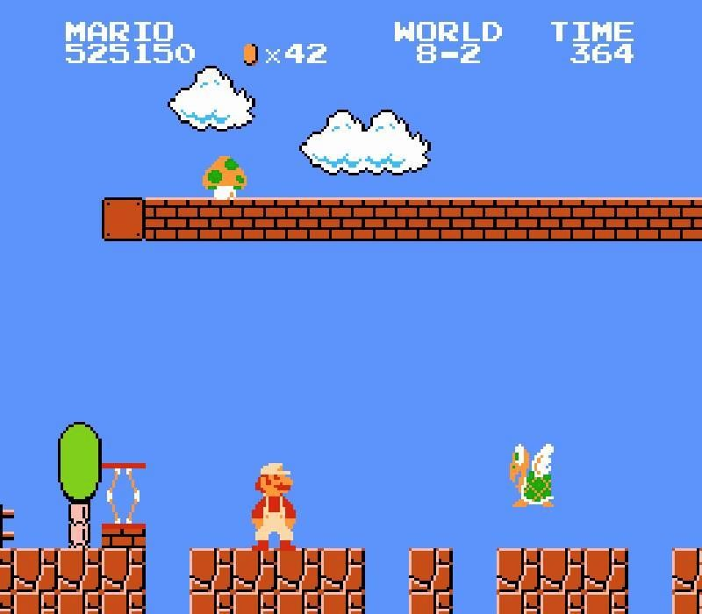
State Representation Examples
List of facts
enemy to right
powerup above
fire mario
on ground
etc…

Slide 57
State Representation Examples
Grid Representations
Segment all locations to tiles
All enemies represented individually? Or just as “enemy”
How much of the level to include in the state? Just screen?
Smaller? Larger?

Slide 58
State Representation Examples
What pixels are present on the screen at this time?

Slide 59
State Representation Tradeoffs
More complex state representations ensure that an agent has all info needed
Less complex state representations speed up training (more states “look” the same)
Goal: find the middle ground. Simplest state representation that still allows for optimal performance

Slide 60
Question
What state representations would you use for the following? Why?
Tic-Tac-Toe
A simple platformer
A real time strategy game (Civilization/Starcraft)

Slide 61
Possible Answers
Tic-Tac-Toe: The Gameboard
Simple platformer: grid of screen width and height, with values for collideable elements, breakable elements, empty spaces, and enemy types (flying, etc)
RTS: World map (?) + list of facts about currently running commands (building troops, moving troops, upgrading building, etc) (?)

Slide 62
Markov Decision Process
S: finite set of states
A: finite set of actions
– What are they in Tic-Tac-Toe? Platformers? RTS?
P(s,s₁): Probability that action a takes us from state s to state s₁
R(s,s₁): Reward for transitioning from state s to state s₁
γ: Discount factor ([0-1]). Demonstrates the difference in importance between future awards and present awards
What is the optimal action a to take for every state s?

Slide 63
Goal of the MDP
Find the optimal action a to take for every state s
We refer to this strategy as the policy
Policy is represented as π(s): S →A
What is the optimal action to take in state s?

Slide 64
MDP: Reward Function
Better understood as “feedback”
An MDP’s reward can be positive or negative
How to give reward? And what reward to give?

Slide 65
MDP: Transition function (P(s|s_{1,}a))
Also sometimes called a forward model
Gives probability of transition from one state to another given a particular action
Typically this is defined at a high level, not an individual state
E.g. When trying to move forward there is a 50% change of moving forward, a 25% change of moving to the left and a 25% chance of moving to the right
Not “when mario is at position (10,15) there is a 80% chance moving right gets mario to (11,15)

Slide 66
Value Iteration
Value Iteration:
every state has a value V(s), generally represented as a table
Known transition probabilities
Known reward for every transition
Algorithm
Start with arbitrary values for all V(s)
Every iteration we update the value of every state according to the rewards we can get from nearby states
Stop when values are no longer changing

Slide 67
Value Iteration Update
V_{k+1}(s) = max_{a} ∑_{s'} P(s'|s,a) (R(s,a,s')+ γV_{k}(s'))

Slide 68
Value Iteration Update
Q_{k+1}(s,a) = ∑_{s'} P(s'|s,a) (R(s,a,s')+ γV_{k}(s’))
V_{k}(s) = max_{a} Q_{k}(s,a)
^This probably looks like gibberish huh?

Slide 69
Value Iteration Update
Q_{k+1}(s,a) = ∑_{s'} P(s'|s,a) (R(s,a,s')+ γV_{k}(s’))
V_{k}(s) = max_{a} Q_{k}(s,a)
Translation:
The value of a particular action a in state s =
the sum across all neighboring states of the
the probability of going from state s to state s’ given action a multiplied by
The reward of entering state s’ by action a from state s plus the discount factor γ multiplied by the current value of state s’

Slide 70
Value Iteration Update
V_{k}(s) = max_{a} Q_{k}(s,a)
The new value of state s is then
the max value within Q_{k}(s,a)

Slide 71
Value Iteration Update
assign V0[S] arbitrarily k ←0
repeat
k ←k+1
for each state s do:
Q_{k+1}(s,a) = ∑_{s'} P(s'|s,a) (R(s,a,s')+ γV_{k}(s')) V_{k}(s) = max_{a} Q_{k}(s,a)
until V_{k}(s) –V_{k+1}(s) < θ:

Slide 72
Get Policy From Value Table
Remember we want the optimal action a for each state s
π[s] = argmax_{a} ∑_{s'} P(s'|s,a) (R(s,a,s')+ γV_{k}[s']) Translation:
Take the value of a that gives the max value…
For each neighboring state and action a
Multiply the transition probability from state s to state s’ with action a by
The sum of
the reward for entering s’ from s with a and
The product of the discount value by the Value table for s’

Slide 73
Question
Give me all the pieces needed to run an MDP for the simple game of your choice
S is the set of all states
A is the set of all actions
P is state transition function specifying P(s'|s,a)
R is a reward function R(s,a,s')

Slide 74
Pros/Cons
Pros
Once value iteration is done running we have an agent that can act optimally in any state very, very quickly (table lookup)
Cons:
Once value iteration is done running
What if we don’t have a transition function? IE we don’t know probability of getting from s to s’?
What if we have a black box that allows us to simulate it…

Slide 75
Seems like we have some extra stuff we don’t really need huh?
Q_{k+1}(s,a) = ∑_{s'} P(s'|s,a) (R(s,a,s')+ γV_{k}(s')) V_{k}(s) = max_{a} Q_{k}(s,a)

Slide 76
Seems like we have some extra stuff we don’t really need huh?
Q_{k+1}(s,a) = ∑_{s'} P(s'|s,a) (R(s,a,s')+ γV_{k}(s')) V_{k}(s) = max_{a} Q_{k}(s,a)
Traditionally, there was a preference for keeping track of V(s) over Q(s,a) as it was smaller

Slide 77
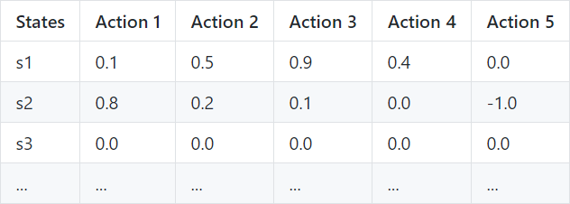
Q-table Update
Q[s,a] ← Q[s,a] + α * (r+γ * max_{a’}Q[s’,a’]-Q[s,a])
A Q-table enumerates all possible states and all possible actions and gives the utility of each action in each state

Slide 78
Q-learning algorithm
Assign Q[S,A] arbitrarily observe current state s repeat
select and carry out an action a observe reward r and state s’
Q[s,a] ← Q[s,a] + α * (r+γ * max_{a’}Q[s’,a’]-Q[s,a])
until termination
learning rate, α, ranges (0,1] 1 if env is deterministic often 0.1
discount factor, γ, ranges [0,1] 0 is myopic, 1 long-term
the learned action-value function, Q, directly approximates the optimal action-value function, independent of the policy being followed

Slide 79
Q Learning
Pros
We don’t need to have a forward model/transition function
Means we can go into an environment blind
Cons
Takes up more memory than Value Iteration as we have to hold a |S|*|A| table instead of just an |S|-sized table
Can be ameliorated with function approximation
Bigger table means (at times) longer to converge

Slide 80
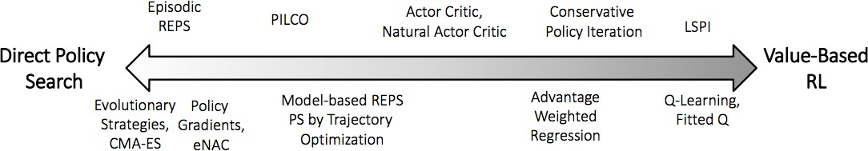
Q Learning
The most general game playing/decision making technique we’ve seen so far
Only needs a reward function, list of actions, and state representation
But that state space sure is too massive to be useful huh?

Slide 81
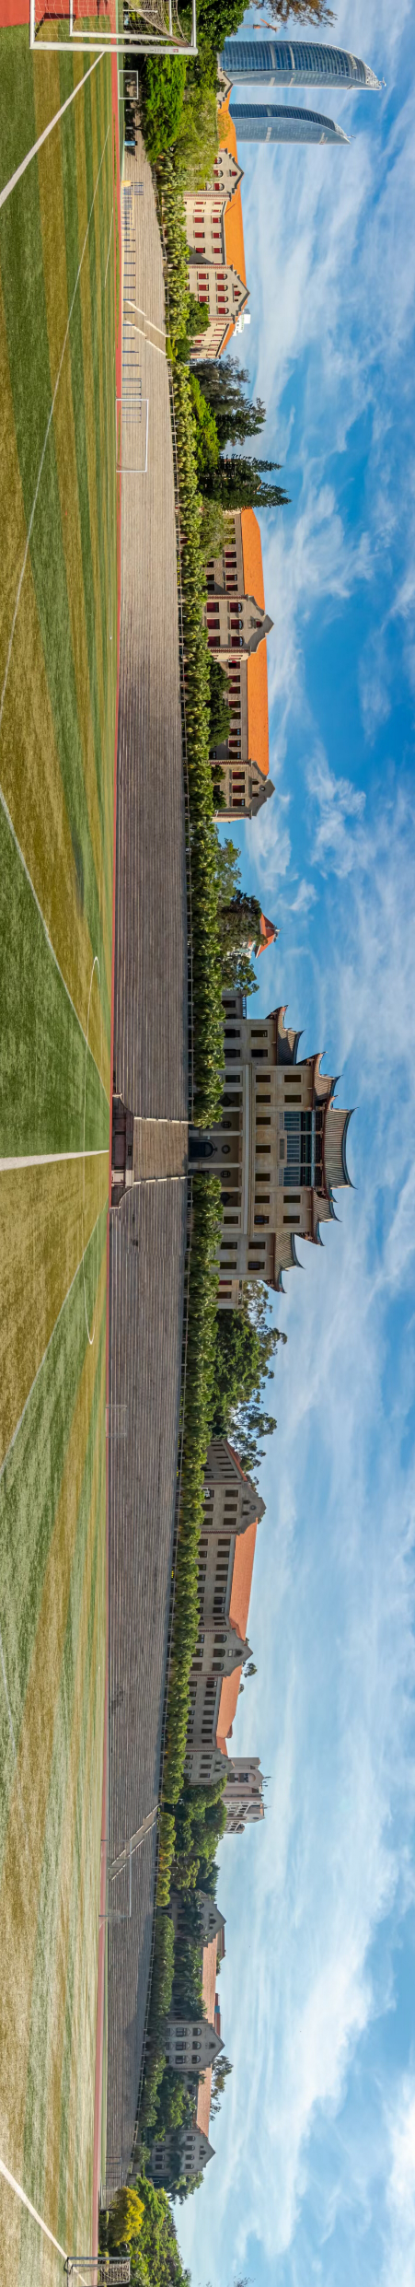
感谢您的观看
Thank you for watching

